Slide 1
Logic
Peter M. Maurer

Slide 2
Propositions
A proposition is a declarative sentence that can be either true or false
  Earth is a planet – True
  The Moon is made of green cheese – False
  There is life on Mars – We don’t know yet, but either there is or there isn’t
Other forms of sentences are not propositions
  What time is it? – Interrogative, not a proposition.
  Shut the door! – Imperative, not a proposition.
  I fit new go. – Nonsense. Not a proposition.
  X+1=2 – Could be true or false, depending on X.
  This sentence is false. – Not a proposition. Why not?

Slide 3
The Law of The Excluded Middle
A proposition is either true or false
There can be no middle ground
Sometimes we don’t know whether a proposition is true or false
  This is not a separate category
  Our lack of knowledge of a fact does not change the fact
Multi-valued logics exist, but they are of no value to us at this point

Slide 4
Compound Propositions
“The moon is round.” is a simple proposition.
From simple propositions, we can create more complex propositions.
These are called compound propositions.
Logical connectives are used to create compound propositions.
“AND” is a logical connective.
“The moon is round AND cows are green.” is a compound proposition.
The truth or falsity of a compound proposition depends on the truth or falsity of its components, i.e. the simple propositions used to create it.

Slide 5
Symbolic Logic
When talking about logic itself, we wish to determine a set of rules that apply to all propositions.
Abstract symbolic logic is used for this purpose.
Variables, usually p, q, and r, are used to designate propositions.
Thus in p=“My dog can sing.” we are allowing the variable p to designate a simple proposition.
Variables can designate any proposition, both compound and simple.
Symbols are used for logical connectives.

Slide 6


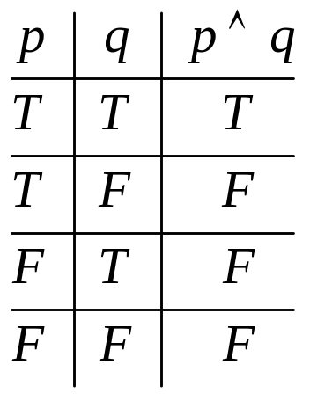
Logical AND
The symbol is used to represent the connective AND.
Logical AND, means pretty much the same thing that the word “and” means in English.
(Very often technical terms sound like English words, but mean something different.)
The truth of is determined by the values of p and q in the following table.

Slide 7


Logical OR
OR is also a logical connective, but means something different than in English
Do you want eggs or pancakes for breakfast?
  This suggests that you can’t have both.
  This is called Exclusive OR, because BOTH is excluded.
Do you know C++ or Java?
  This suggests that you might know both.
  This is called Inclusive OR, because BOTH is included.
In Logic we use INCLUSIVE OR.
We use the symbol to designate OR.
As with AND, the truth or falsity of is determined by the truth or falsity of p and q.

Slide 8

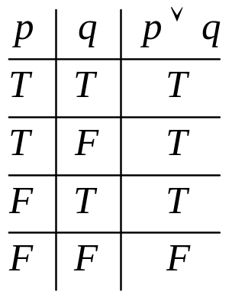
Inclusive OR
The following table shows how the truth or falsity of is determined.
Note that the first row is the BOTH possibility.

Slide 9


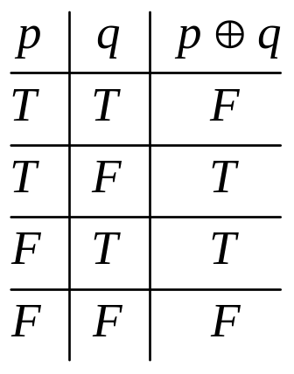
Exclusive OR
Although Exclusive OR is seldom used in formal logic, it has important applications in Computer Science.
We use the symbol to represent Exclusive Or.
The designation XOR is also used. (I prefer this.)
The following table shows how the truth or falsity of is determined.

Slide 10


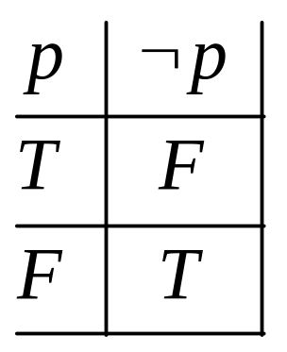
NOT
The simplest logical connective is NOT.
NOT has a single operand and is designated using the symbol .
As with the other connectives, the truth or falsity of is determined by the truth or falsity of p, as in the following table.

Slide 11

Functionally Complete Sets
There are many other logical connectives, but AND, OR, and NOT are enough to express any sort of logical relationship.
The set {AND, OR, NOT} is called a functionally complete Set of Connectives, for this reason.
There are many other functionally complete sets, one of which is {XOR, AND}.
The sets {AND, NOT} and {OR, NOT} are also functionally complete.
For example, XOR can be expressed as

Slide 12
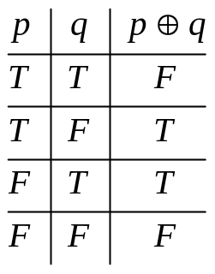


Truth Tables
Things like this are called truth tables:
Using multiple connectives, and possibly parentheses, we can make arbitrarily complex logical expressions
Every logical expression has a truth table.
Sometimes we must use precedence rules to disambiguate an expression. The precedence from high to low is:
We use the symbol to indicate that two expressions have the same truth table, as in

Slide 13


Other Connectives
There are many other connectives that are in common use.
Strictly speaking, these are not necessary, because AND, OR, and NOT cover everything. They are used primarily for convenience.
The major ones are:
  Implication:
  Equivalence: (also known as XNOR)
  NAND
  NOR

Slide 14



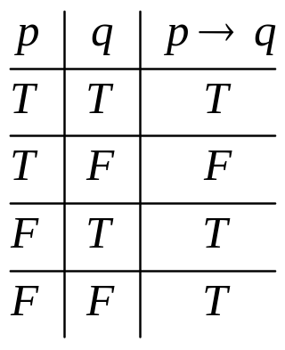
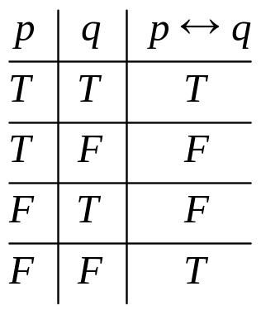
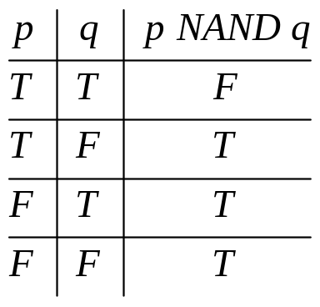

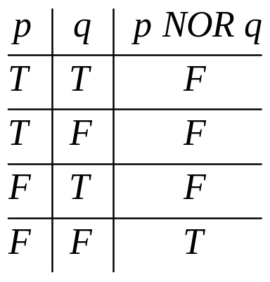
Other Connective Truth Tables

Slide 15

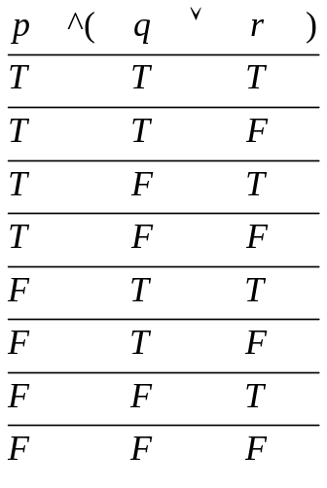
Computing a Truth Table
Start with:
Add True and False values for the variables:
For the first variable, half trues then half falses.
For each subsequent variable, For each group of Trues, set half true and half false. Same for each group of falses.

Slide 16
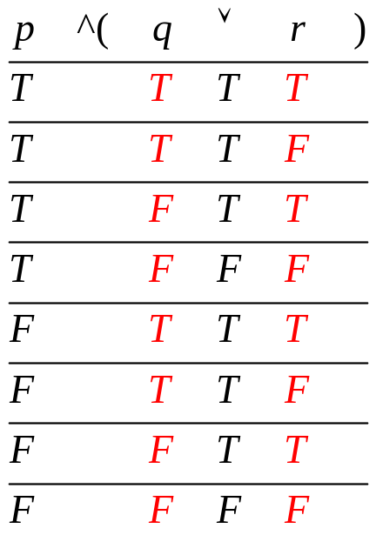
Computing a Truth Table II
In precedence order, honoring parentheses, evaluate each connective, and write the result under the connective.
Mark off the truth values that have been used.
Step 1:

Slide 17
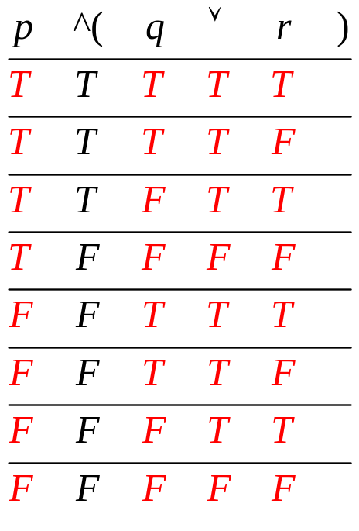
Computing a Truth Table III
When all connectives have been computed, the remaining unmarked column is the desired truth table.
Step 2:

Slide 18


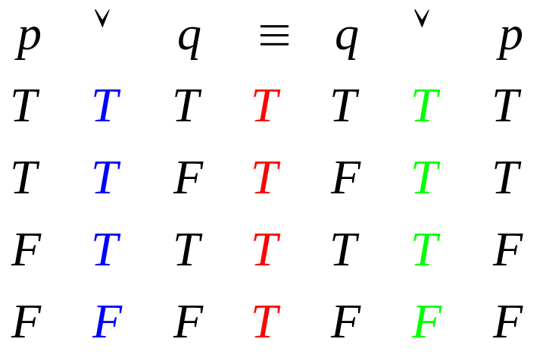
Logical Identities
There are many well known logical identities, such as .
Remember that means that the two logical expressions have the same truth table.
We can prove the identity by computing the truth tables, and showing that the entries are the same.

Slide 19
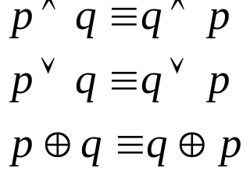
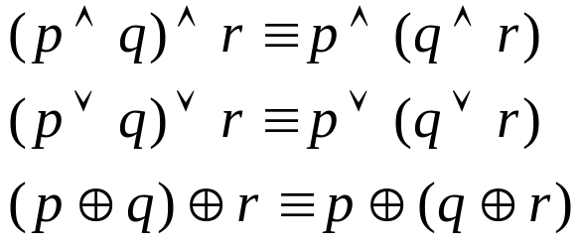
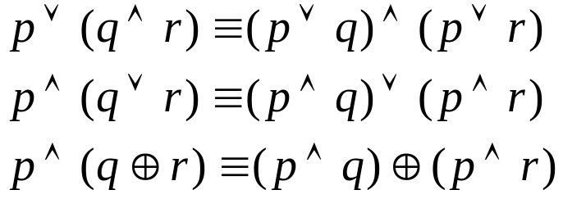
Standard Identities
Commutative Laws
Associative Laws
Distributive Laws

Slide 20
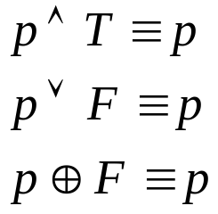

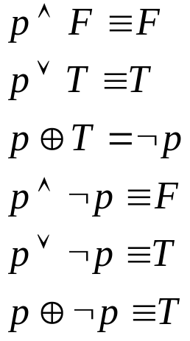
More Standard Identities
Identity Laws
Double Negative
Other Laws

Slide 21






DeMorgan’s Laws
DeMorgan’s Laws show how to negate complex statements.
To negate a complex statement, we negate each of the variables, change the ANDs to ORs and the ORs to ANDs.
Example:
Negate
The negation of is

Slide 22


Implications
The logical expression is read “if p then q”
This is known as a conditional statement.
Most mathematical statements are conditional statements.
Consider the expression (x+1)²=x²+2x+1
  Is this statement true?
  What if x is a cow?
  This statement starts with the assumption “if x is a number”
The statement is called the converse of .
  The two statements are independent.
  One can be true and the other false, both can be true, or both can be false.

Slide 23

Converses
If this animal is a dog, then it must be a mammal (true)
If this animal is a mammal, then it must be a dog (the converse is false)
(Note that and are converses of one another.)
If x=y then x+1=y+1 (true)
If x+1=y+1 then x=y (the converse is true)
If x=3 then x=2 (false)
If x=2 then x=3 (the converse is also false)

Slide 24





Other Forms of the Implication
The statement is called the contrapositive of .
The following identity is true .
If I want to prove , I’m free to prove
instead.
If this animal is not a mammal, then it cannot be a dog (contrapositive is true.)
The statement is called the inverse of .
The inverse of is the contrapositive of the converse of .

Slide 25

True and False Implications
is false ONLY when p is true and q is false.
If 1+1=1 then I am the pope. (a true statement)
  Proof. I and the pope are two.
  If 1+1=1, then because 1+1 is two, 2=1
  In other words 1 and two are the same.
  If I and the pope are two, and if two and one are the same, then the pope and I are one, and I am pope.
A false statement implies anything.
You already know this.
“If Hillary Clinton is a great computer programmer, then I’m a monkey’s uncle!”
Have you ever said anything like this?

Slide 26
A Weirder Example
The Earth rotates from West to East, making the sun rise in the East. (a true fact)
If the Earth’s rotation were reversed, so it rotated from East to West, then the sun would still rise in the East.
  True in math class.
  False in physics class.
Because mathematics deals only with abstractions, there is no physical world to give us a paradox
Math just works better if a false statement is assumed to imply anything.
Statements such as “If 1+1=17 then I am a millionaire” are called vacuously true. They are true, but so what?

Slide 27
Predicates
Statements with variables are called Predicates
For example, Person x likes to juggle.
This statement could be true or false, depending on who x is. It would be true for Dr. Hamerly, and false for me.
Other examples are x+3=2, 2x+y>7 and 3x²=2x²
To distinguish predicates from propositions, we designate predicates as P(x), where P is the statement, and x is the variable.
Let P(x)=“x+3=2”
P(1) is false. P(-1) is true.

Slide 28






Quantifiers
There are two ways to turn a predicate into a proposition. The first is to substitute actual values for the variables.
The second is to use quantifiers: “For all” and “There exists”. (There are others, but they’re not important.)
Example “For all x, (x+1)²=x²+2x+1”
Example “There exists an x such that x+3=2”
Both are true statements.
means “For all,” means “for all x” (sometimes
means “there exists” means “there exists an x such that” (sometimes )

Slide 29
Negating Quantified Predicates
 is called the universal quantifier.
 is called the existential quantifier.
To negate a quantified predicate, first negate the predicate and then replace  with  and  with .
➢(x (x+1)²=x²+2x+1)  x (x+1)²x²+2x+1
➢(x x+3=2)  x x+32
Please NOTE:
  The negation of < is 
  Then negation of > is 
  DON’T FORGET THIS!

Slide 30
Rules of Inference
Consider this argument:
  1. My dog got bit by a raccoon yesterday.
  2. My shoelace broke this morning.
  3. Therefore Baylor was destroyed by an earthquake.
This is a logical fallacy known as Non Sequitur
Line 3 does not follow from lines 1 and 2.
Rules of inference help us avoid the Non Sequitur argument.
An inference consists of a set of n propositions known to be true, followed by one more proposition, called the conclusion, that MUST be true if the first n are true.

Slide 31
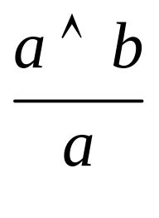
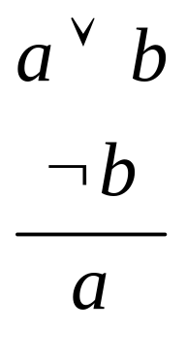
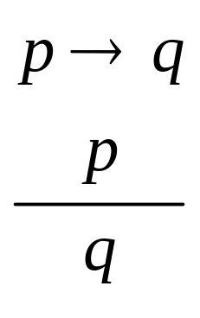
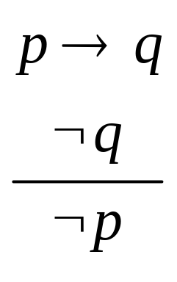
Examples of Valid Inferences
In the following, the known-to-be-true statements are listed above the line, the conclusion falls below the line.

Slide 32
Validating Rules of Inference
How do I know the following is correct?

Slide 33
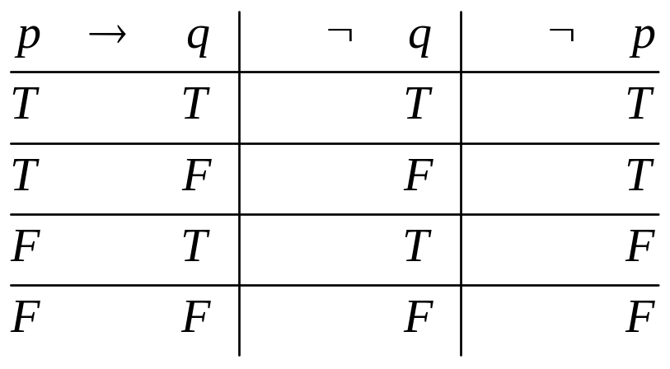
Validating Rules of Inference Step 1
List the truth tables of all propositions involved in the inference.

Slide 34
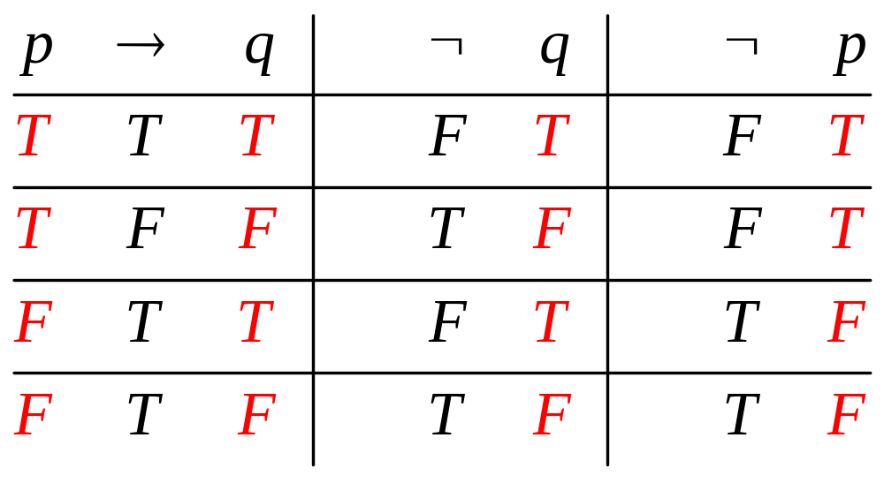
Step 2: Evaluate The Tables

Slide 35
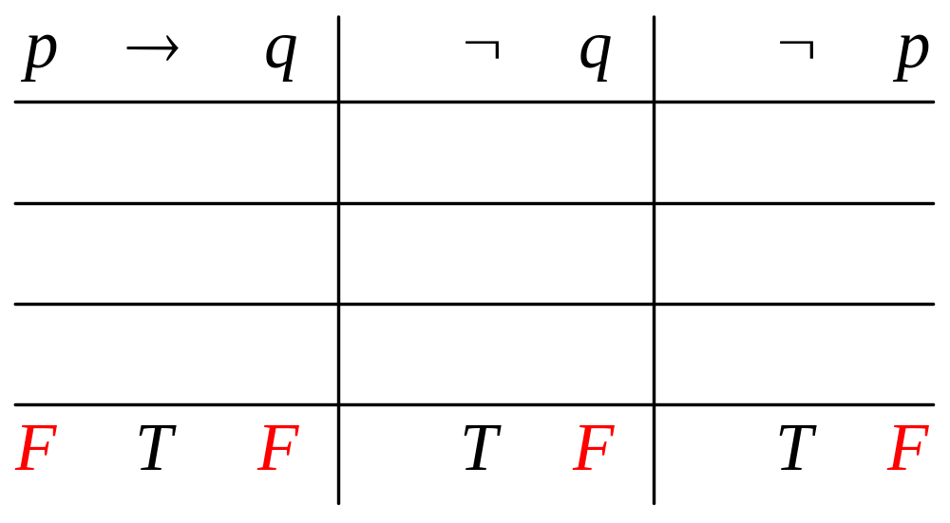
Step 3: Clear the Falses
Eliminate any line where any known-to-be-true proposition is false
If the conclusion is true in all the remaining lines, then the inference is valid. Otherwise, it is not.

